Slide 1
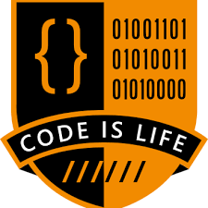
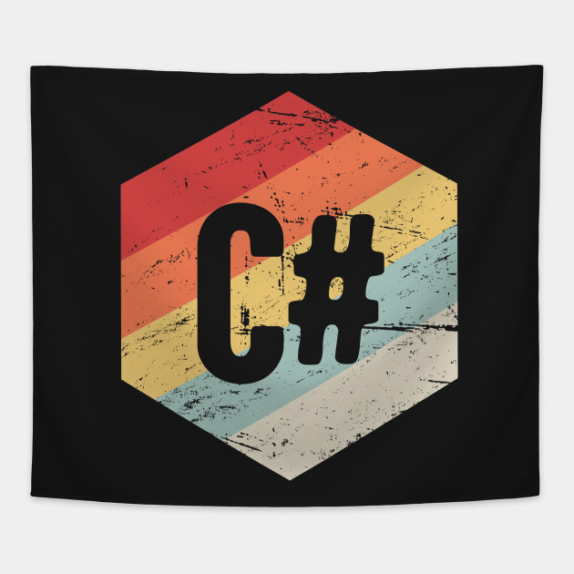


Introduction To C# Programming Language
About Author
Name : Tashik Moin Sheikh
University : National University Of Computer & Emerging Sciences, FAST-Karachi.
GitHub : TashikMoin23
Email : TashikMoinSheikh@Gmail.Com
Mobile : +92 3000 212027
Microsoft Student Partner

Slide 2


Slide 3
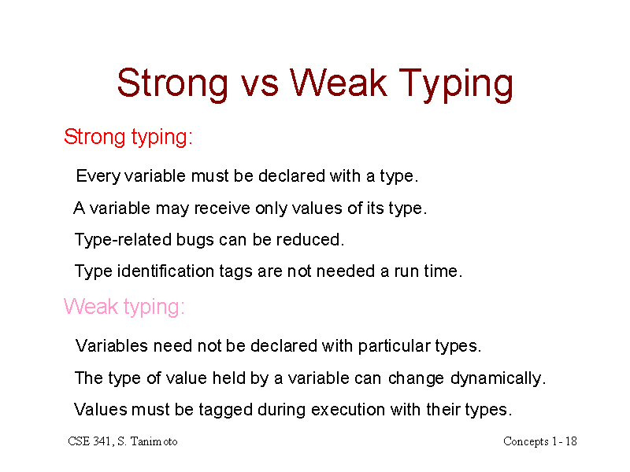

Slide 4
Type Checking & Its Importance ?
Type checking is the process of verifying and enforcing the constraints of types, and it can occur either at compile time (i.e. statically) or at runtime (i.e. dynamically).
Type checking is all about ensuring that the program is type-safe, meaning that the possibility of type errors is kept to a minimum.
A type error is an erroneous program behavior in which an operation occurs (or try to occur) on a particular data type that it’s not meant to occur on. For e.g. This could be a situation where an operation is performed on an integer with the intent that it is a float, or even something such as adding a string and an integer together: int x = 10 + “Ali” ;

Slide 5
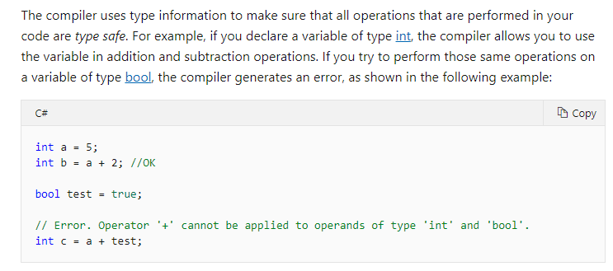

Slide 6
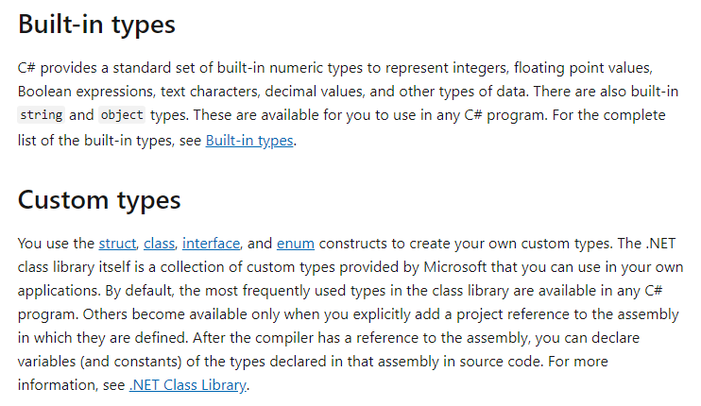

Slide 7
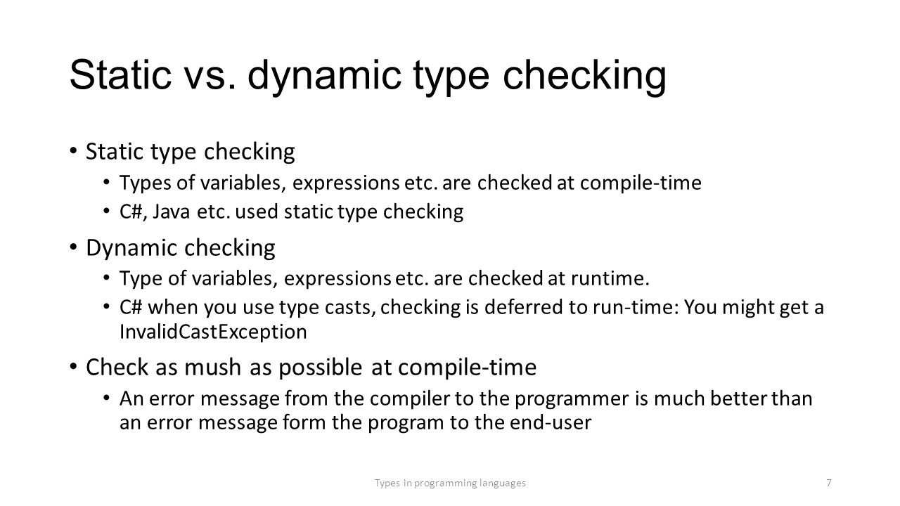

Slide 8
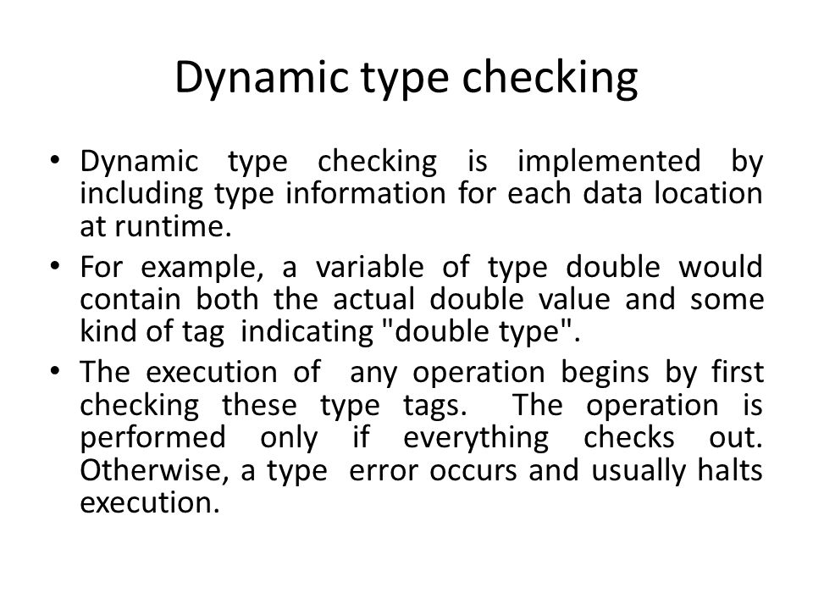

Slide 9
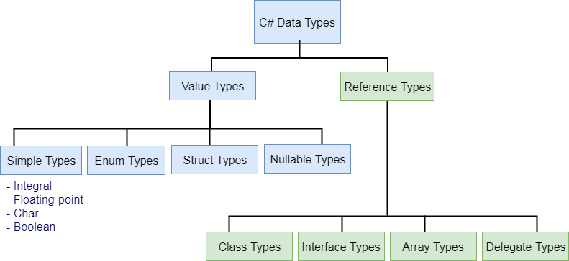

Slide 10
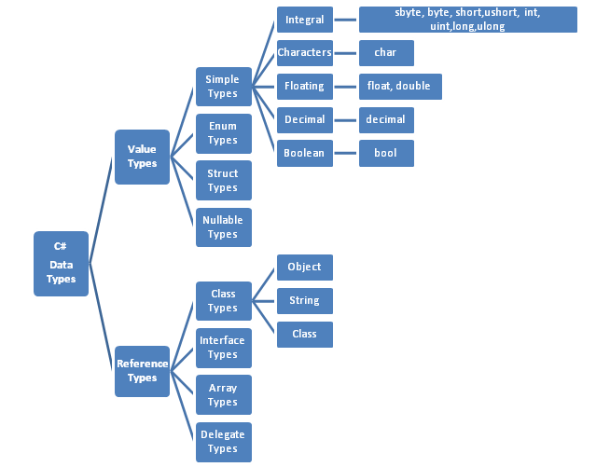

Slide 11
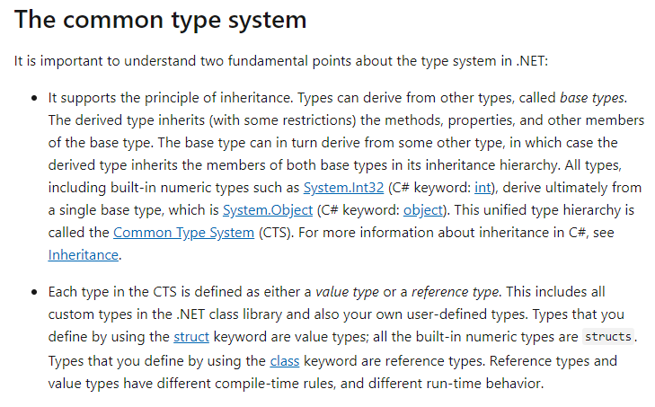

Slide 12
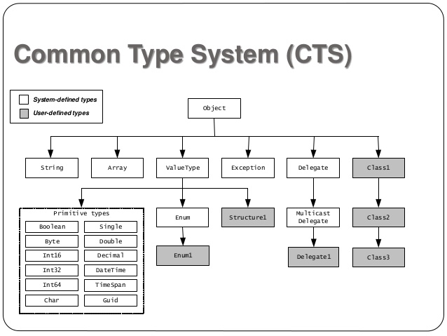

Slide 13
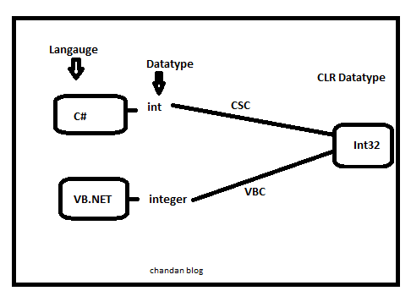
Common Type System CTS In .NET

Slide 14
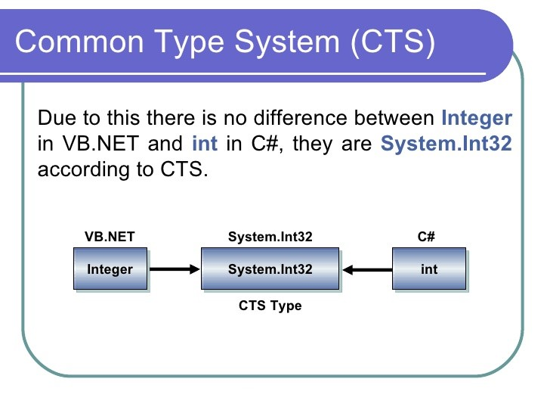
HHHH
KKKKKK
ZZZZ

Slide 15
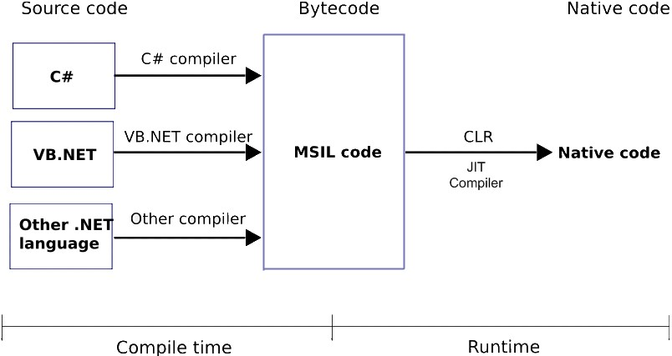
.NET & C# Compilation Process

Slide 16
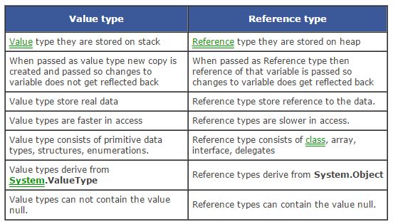

Slide 17
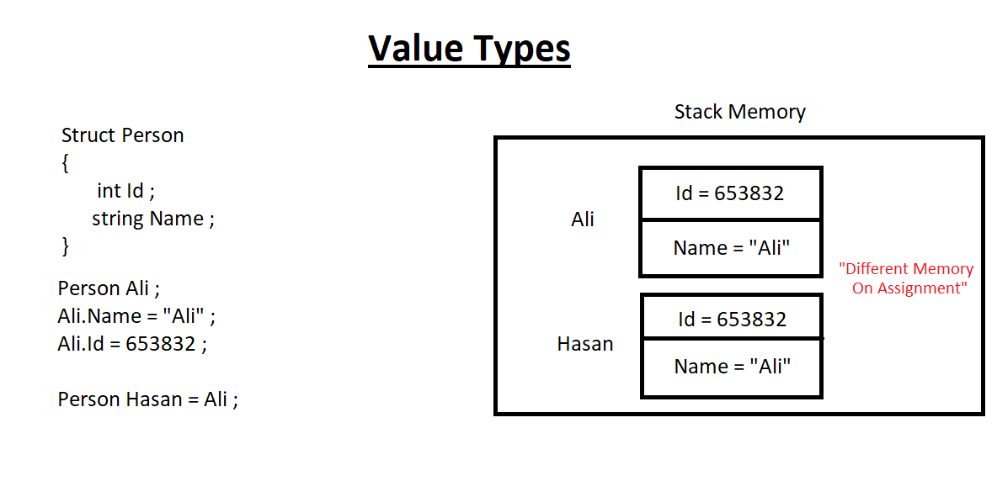

Slide 18
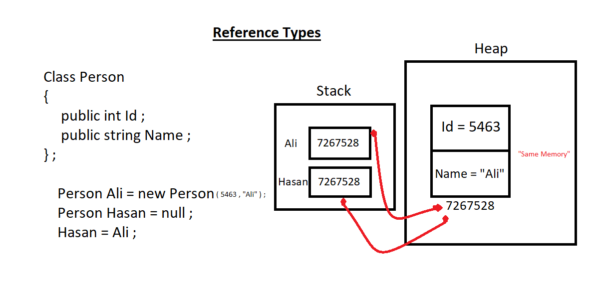

Slide 19
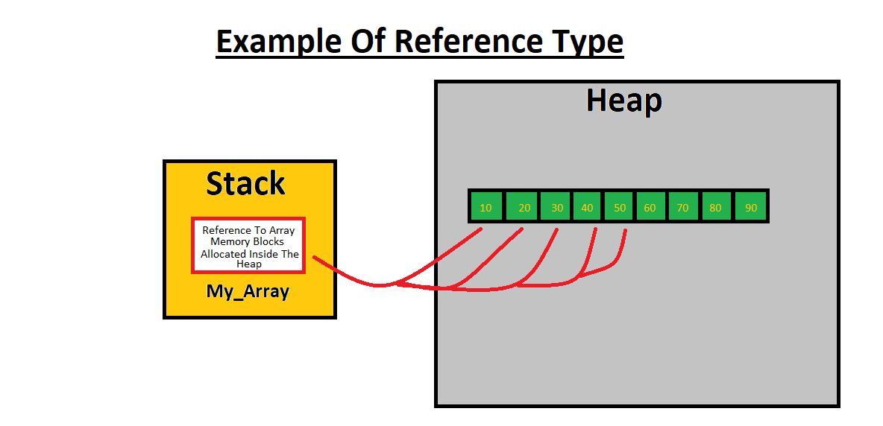

Slide 20
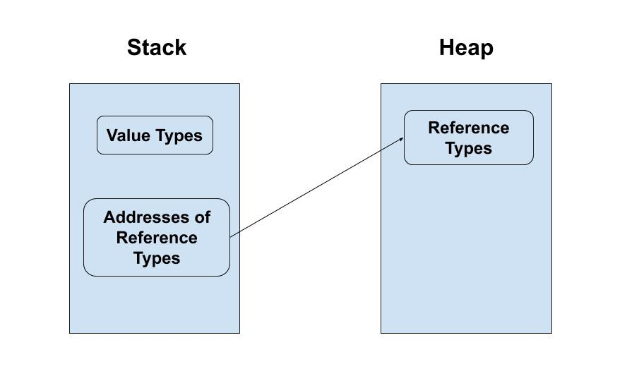

Slide 21
Size Of Reference Variables VS Size Of Memory Block In Heap
- The memory space used by a pointer or a reference generally depends on the type of system i.e. 32 bit or 64 bits. A pointer stores the address of a variable. Now the address bits needed will depend upon the computer architecture, i.e. 32 bits have 4 byte memory for pointers and 64 bits take 8 bytes.
- The memory space used by a block is dependent on the total value types it has.

Slide 22
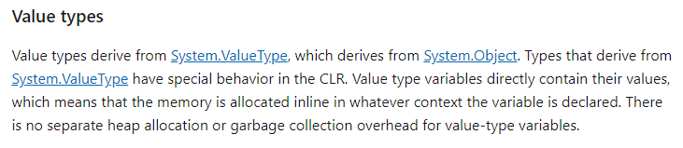
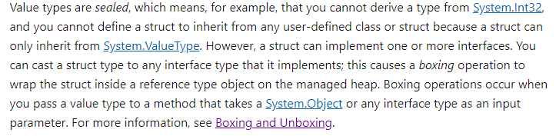

Slide 23
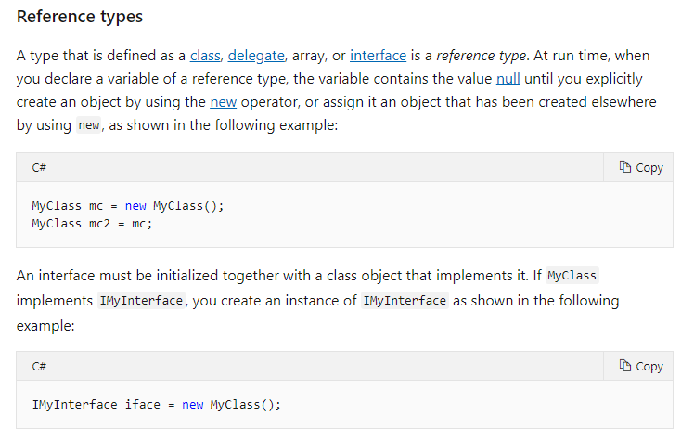

Slide 24
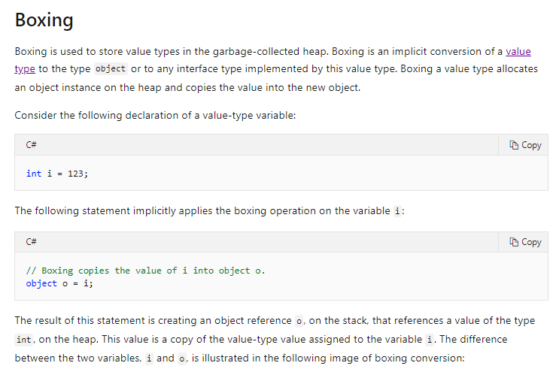
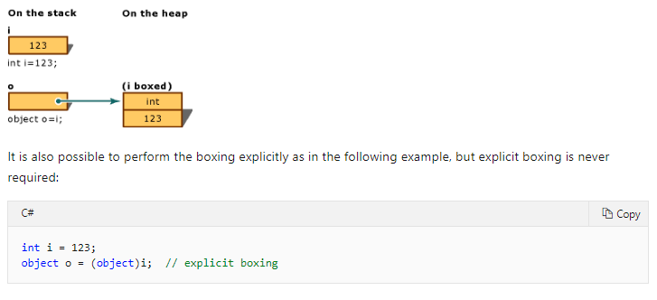

Slide 25
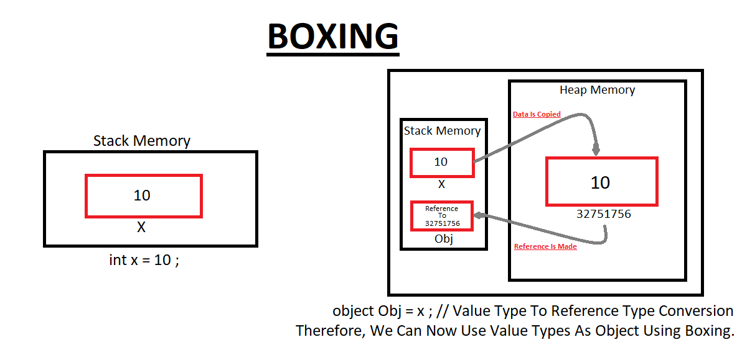
Situation After Boxing
Situation Before Boxing

Slide 26
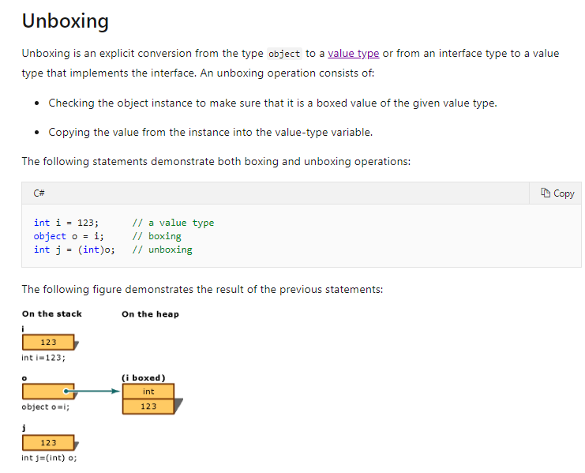

Slide 27
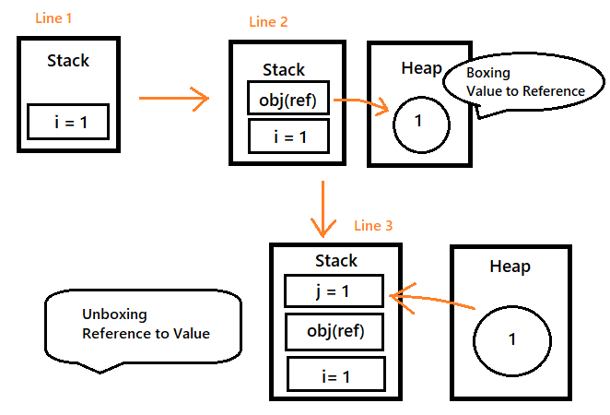

Slide 28
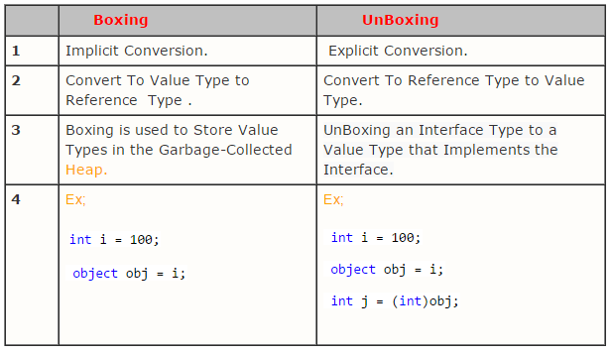

Slide 29
Why Boxing & Unboxing Is Important ?
Boxing and unboxing is an important concept in C#. Basically it convert a Value Type to a Reference Type, and vice versa. Boxing and Unboxing enables a unified view of the type system in which a value of any type (Reference Or Value) can be treated as an object (A generalized or a unified way to represent types). So, if you don't care about having a unified type system (i.e., reference types and value types have very different representations and you don't want a common way to "represent" the two) then you don't need boxing.
Note : For Unboxing, you can only unbox those types that were boxed earlier (Value types) because we can not unbox a built-in reference type. For example, you can not unbox a string and make it a value type and store it inside stack memory. It is not possible to unbox built-in reference types such as delegates, strings, class etc.
Similarly, We can not box reference types. For example, we can not box an array and bring it into our stack. This operation is not allowed

Slide 30
